Slide 1
Cleaning and Exploring RowColumn Data
Datascience for Beginners, Session 5
Notes:
We’re talking today about cleaning and exploring data. What we’re really talking about is making friends with your data; understanding it yourself before you run any algorithms (e.g. machine learning algorithms) on it. We do this because a) it’s hard to run algorithms on badly-formatted data, and b) discovering data issues when you’re trying to train a classifier sucks - you have enough on your hands without dealing with outliers and spelling errors too.

Slide 2
Session 4 (Communicating Results) recap
Communicating with data
Really common visualisations
Quite common visualisations
Matplotlib
Tableau
D3 and beyond

Slide 3
Session 5: your 5-7 things
Data cleaning
Basic data cleaning with Python
Using OpenRefine
Exploring Data
The Pandas library
The Seaborn library
The R language

Slide 4
Exploring and Cleaning Data
Eyeball your dataset
Get the basics statistics (mean, sd etc) of your data
Understand how data columns interact
Clean your data
Plot your data (visually look for trends and outliers)
Do more cleaning if you need to (e.g. those outliers)
Notes:
Get to know your dataset, before you ask a machine to understand it.

Slide 5
Data Cleaning
Notes:
Data cleaning is the process of removing errors (spelling mistakes, extraneous characters, corrupted data etc) from datafiles, to prepare them for use in algorithms and visualisation. Data cleaning is sometimes also called data scrubbing or cleansing.

Slide 6
Algorithms want their data to be:
Machine-readable
Consistent format (e.g. text is all lowercase)
Consistent labels (e.g. use M/F, Male/Female, 0/1/2, but not *all* of these)
No whitespace hiding in number or text cells
No junk characters
No strange outliers (e.g. 200 year old living people)
In vectors and matrices
Normalised
Notes:
Normalised: each datapoint has its own row in the data matrix.

Slide 7
Cleaning with Python

Slide 8
Cleaning Strings
Removing capitals and whitespace:
  mystring = " CApiTalIsaTion Sucks ”
  mystring.lower().strip()
  Original text: “CApiTalIsaTion Sucks “
  Lowercase: “ capitalisation sucks “
  Without leading/trailing spaces: “capitalisation sucks”
Notes:
Basic text cleaning
We'll spend a lot of time cleaning up text. Mostly this is because:
A) although you see 'Capital' and 'capital' as the same words, an algorithm will see these as different because of the capital letter in one of them
B) people leave a lot of invisible characters in their data (NB they do this to string representations of numerical data too - and many spreadsheet programs will store numbers as strings) - this is known as "whitespace", and can really mess up your day because "whitespace" and "whitespace " look the same to you, but an algorithm will see as different.
In the example, lower() converts a string into lowercase (upper() converts it into uppercase, but the convention in data science is to use all-lowercase, probably because it's less shouty to read), and strip() removes any whitespace before the first character, and after the last character (a-z etc) in the string.

Slide 9
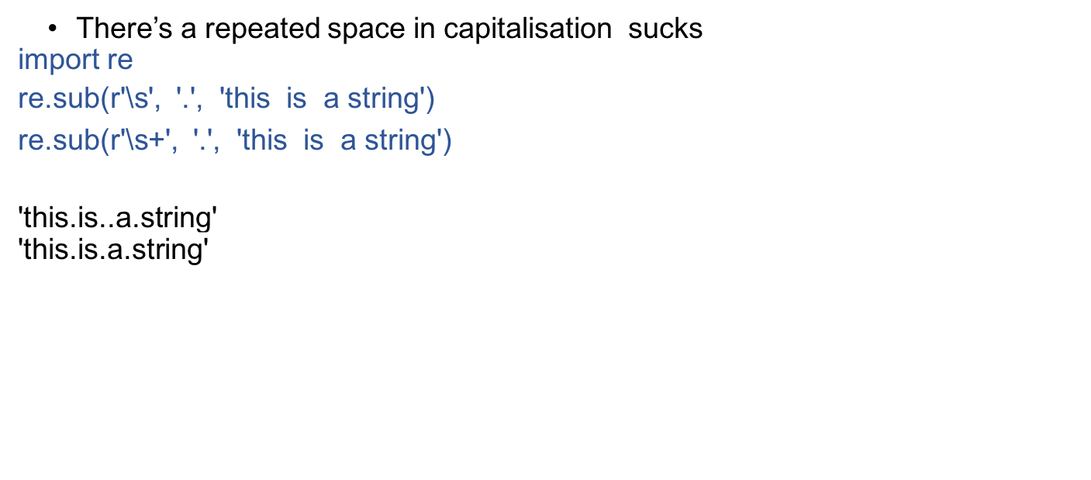
Regular Expressions: repeated spaces
Notes:
Use the RE (regular expression) library to clean up strings. To use a regular expression (aka RegEx), you need to specify two patterns: one input pattern that will be applied repeatedly to the input text, and one output pattern that will be used in place of anything that matches the input pattern.
Regular expressions can be very powerful and can take a while to learn, but here are a couple of patterns that you’ll probably find helpful at some point; http://rubular.com/ is a great place to play around with these.

Slide 10
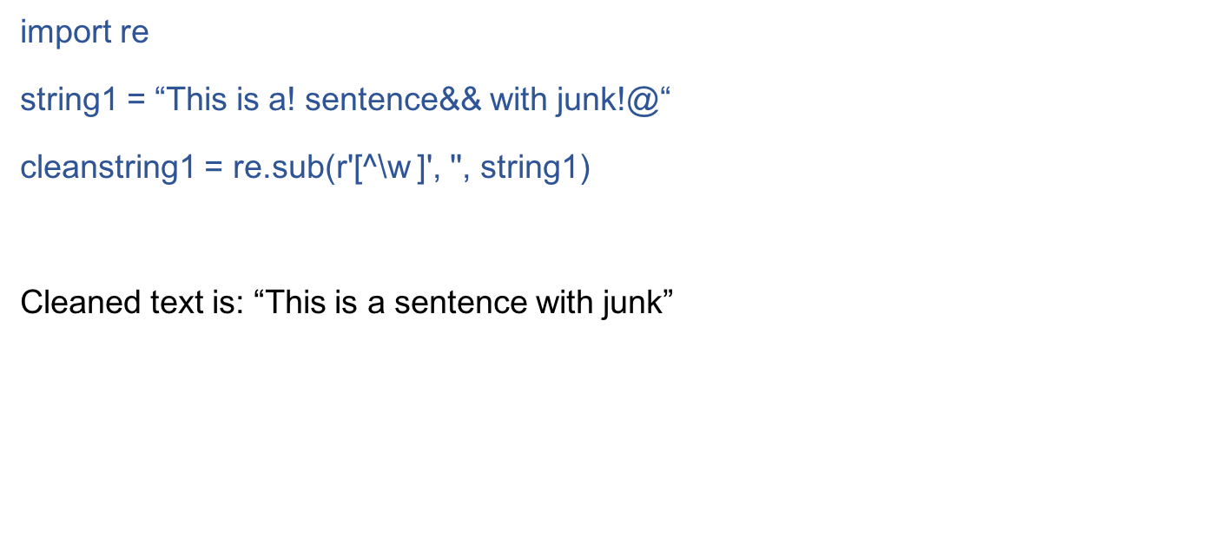
Regular expressions: junk
Notes:
^\w = everything that isn’t a character or number.
[] = a group of possible characters, e.g. [^\w ] = alphanumeric plus space.
\s+,\s+ = one or more spaces followed by a comma then one or more spaces

Slide 11
Converting Date/Times
European vs American? Name of month vs number? Python comes with a bunch of date reformatting libraries that can convert between these. For example:
import datetime
date_string = “14/03/48"
datetime.datetime.strptime(date_string, ‘%m/%d/%y').strftime('%m/%d/%Y')
Notes:
More about date formats in https://docs.python.org/3/library/datetime.html

Slide 12
Cleaning with Open Refine
Notes:
Open refine is a powerful data cleaning tool. It doesn’t do the cleaning for you, but it does make doing repeated tasks much much easier.

Slide 13
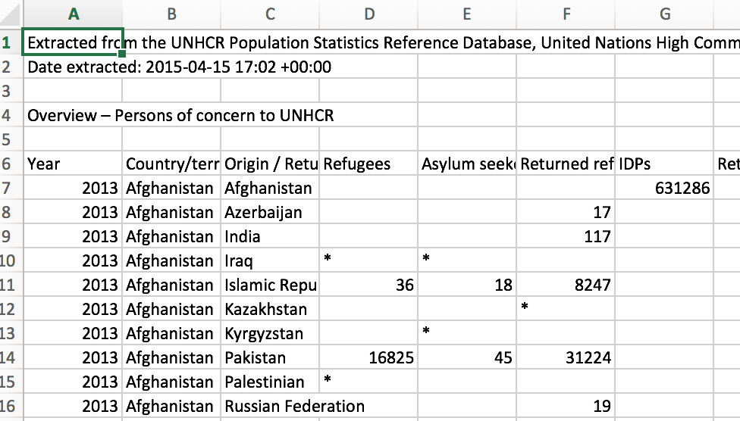
Our input file
Notes:
This is file 2009_2013_popstats_PSQ_POC.csv in directory notebooks/example_data

Slide 14
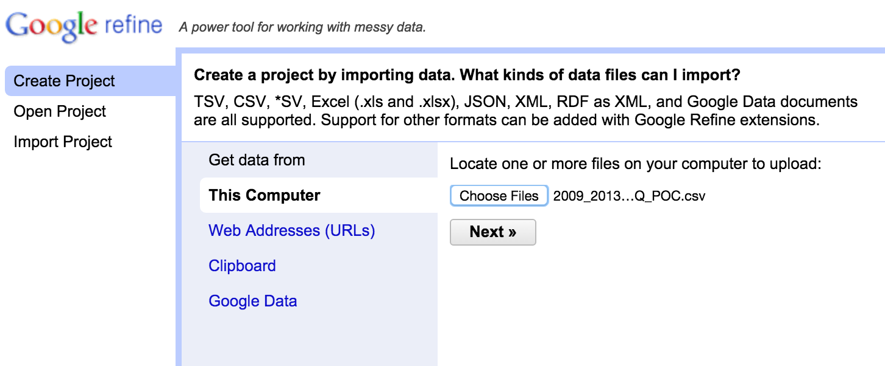
Getting started
Notes:
First, click on the OpenRefine icon. This will start a webpage for you, at URL 127.0.0.1:3333
Click on create project, then select a file. Click “next”.

Slide 15
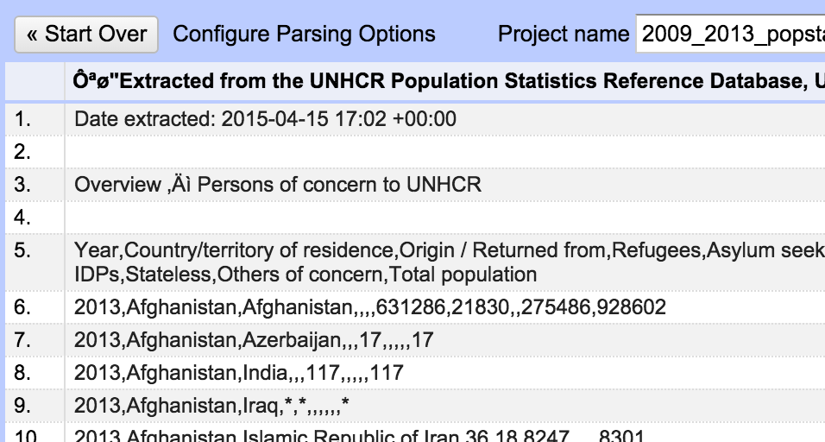
Inputting data
Notes:
I’ve selected file Notebooks/example_data/2009_2013_popstats_PSQ_POC.csv
Now I can see a preview of the data as it will be fed into the system, and a set of buttons for changing that import. And it’s a mess. OpenRefine has put all the data into one column - it’s ignored the commas that separate columns, and it’s used the first row (which is a comment about the file) as the column headings.

Slide 16
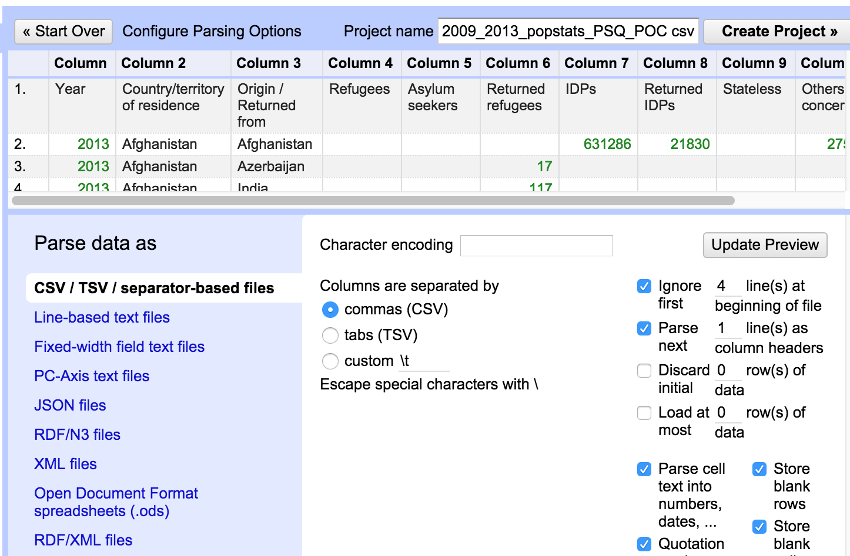
Cleaning up the import
Notes:
Fortunately, OpenRefine has ways to start cleaning as you import the file. Here, we’ve selected “commas” as the column separators, and told OpenRefine to ignore the first 4 lines in the file. Now all we’ve got left to do is to clean up those annoying “*”s.
First, click on “create project”.

Slide 17
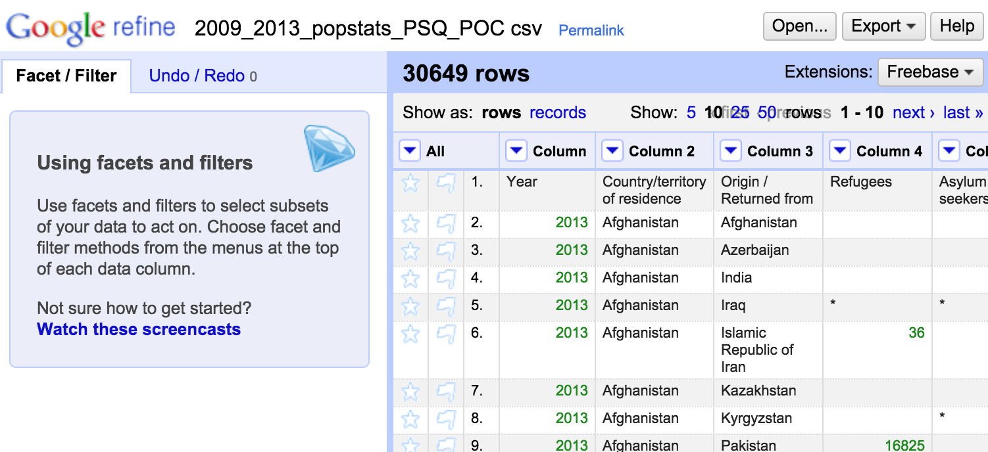
The imported data
Notes:
Here’s your data. You can do many things with this: clean text en-masse, move columns around (or add and delete columns), split or merge data in columns. We’ll play with just a few of these things.

Slide 18
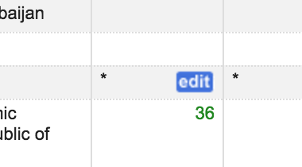
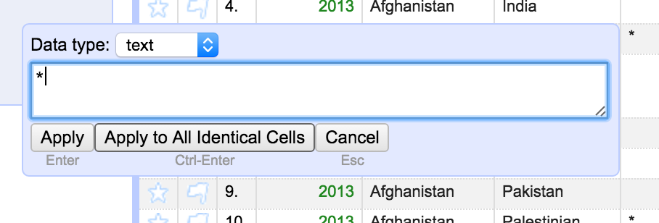
Cleaning up columns
Notes:
If you right-click on a cell that you want to change, a little blue “edit” box will appear. Click on this, then edit the box that appears.
Now a powerful thing happens. You can apply whatever you did to that cell, to all other identical cells in this column. So if I want to remove cells with ‘*’ in them, I click on one of them, edit out the star, then click on “apply to all identical cells”.

Slide 19
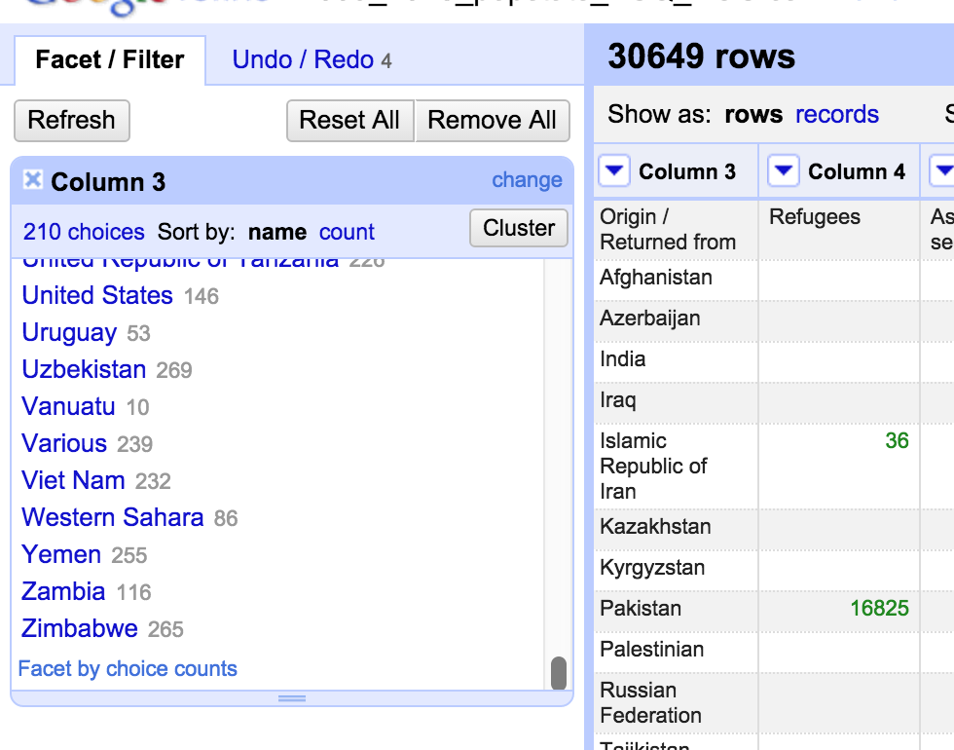
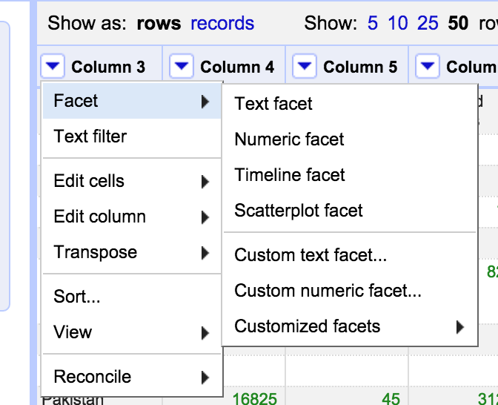
Facets
Notes:
Facets are also really powerful ways to look at and edit the data in cells. For instance, if you click on the arrow next to “column 3”, you’ll get a popup menu. Click on “facet” then “text facet”, and a facet box will appear on the left side of the screen. Now, if you want to change every instance of “Viet Nam” to “Vietnam”, you just need to edit the text here (hover over the word “Viet Nam” and an “edit” box will appear.
If you have really messy inputs, you can cluster them (see the “cluster” button?) into similar fields, and assign the text that should replace everything in the cluster. This is a useful way to deal with spelling variations, misspellings, spaces etc.
When you’re finished, click “export” (top right side of the page) to write your data out to CSV etc.
I’ve just shown you some of OpenRefine’s power. There’s more: for example, there are a bunch of OpenRefine recipes at https://github.com/OpenRefine/OpenRefine/wiki/Recipes

Slide 20
Exploring with Pandas
Notes:
Pandas is a Python data analysis library.

Slide 21
Reading in data files with Pandas
Functions: read_csv, read_excel, read_sql, read_json, read_html, read_stata, read_clipboard, to_csv, etc
import pandas as pd
df = pd.read_stata('example_data/AG_SEC12A.dta') # read file
df.to_csv('mynewcsvfile.csv') # write data to file
Notes:
Read_sql reads database files; read_html reads tables from html pages; read_clipboard reads from your PC’s clipboard.
Beware: if you have more columns of data than you have column headings, Pandas read_csv can fail. If this happens, there are lots of optional parameters to read_csv that can help, but in practice it’s better to feed in clean data.

Slide 22
Eyeballing rows
How many rows are there in this dataset?
  len(df)
What do my data rows look like?
  df.head(5)
  df.tail()
  df[10:20]

Slide 23
Eyeballing columns
What’s in these columns?
df[‘sourceid’]
df[[‘sourceid’,’ag12a_01','ag12a_02_2']]
How do you filter columns?
  df[df.ag12a_01 == ‘YES’]
  df[(df.ag12a_01 == 'YES') & (df.ag12a_02_1 == 'NO')]
Notes:
df[k].unique()

Slide 24
Summarising columns
What are my column names and types?
  df.columns
  df.dtypes
Which labels do I have in this column?
  df['ag12a_03'].unique()
  df['ag12a_03'].value_counts()
What are my columns’ mean, standard deviation etc?
  df.describe
Notes:
NB df.describe will only find mean and standard deviation for numerical columns - which is reasonable.

Slide 25
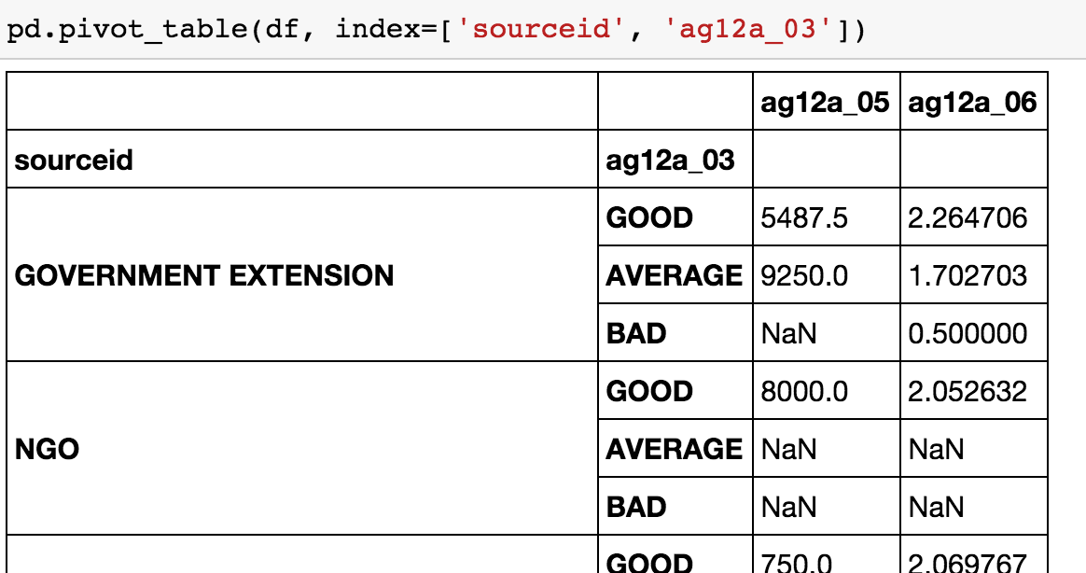
Pivot Tables: Combining data from one dataframe
pd.pivot_table(df, index=['sourceid', 'ag12a_03'])
pd.pivot_table(df[['sourceid','ag12a_03','count']], index=['sourceid', 'ag12a_03'], aggfunc='sum')
Notes:
This is very similar to the pivot tables in Excel. More at http://pbpython.com/pandas-pivot-table-explained.html
Those NaNs? “Not a numbers”.

Slide 26
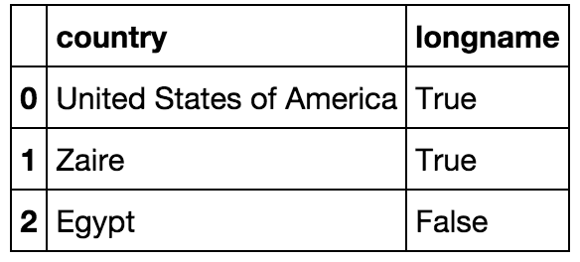
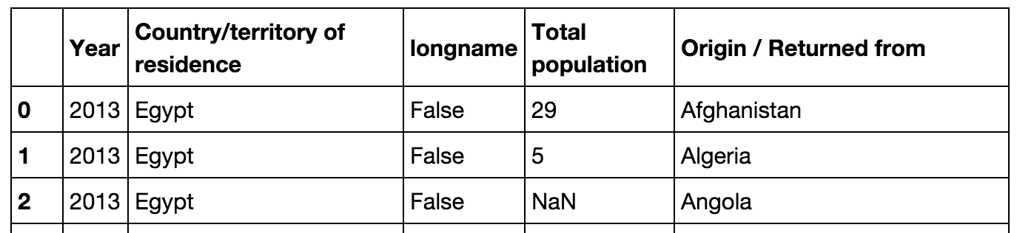
Merge: Combining data from multiple frames
longnames = pd.DataFrame({ 'country' : pd.Series(['United States of America', 'Zaire', 'Egypt']),
'longname' : pd.Series([True, True, False])})
merged_data = pd.merge(
left=popstats,
right=longnames,
left_on='Country/territory of residence',
right_on='country')
merged_data[['Year', 'Country/territory of residence', 'longname', 'Total population', 'Origin / Returned from']]
Notes:
Pandas merge defaults to an ‘inner join’: only keep the rows where data exists in *both* tables. More details in e.g. http://www.datacarpentry.org/python-ecology/04-merging-data
NB you’ll need to read in the popstats dataset before running this code:
popstats = pd.read_csv('example_data/cleaned_popstats.csv')

Slide 27
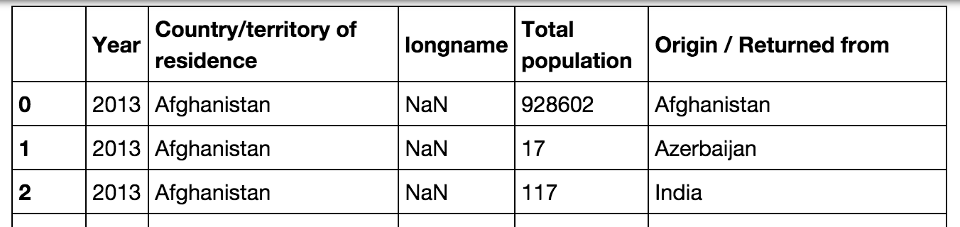
Left Joins: Keep everything from the left table…
longnames = pd.DataFrame({ 'country' : pd.Series(['United States of America', 'Zaire', 'Egypt']),
'longname' : pd.Series([True, True, False])})
merged_data = pd.merge(
left=popstats,
right=longnames,
how='left',
left_on='Country/territory of residence',
right_on='country')
merged_data[['Year', 'Country/territory of residence', 'longname', 'Total population', 'Origin / Returned from']]
Notes:
Left join: keep all rows from the first table; combine rows where you can, put “NaN”s in the rows when you can’t.
Some great visuals about joins: http://www.codeproject.com/Articles/33052/Visual-Representation-of-SQL-Joins

Slide 28
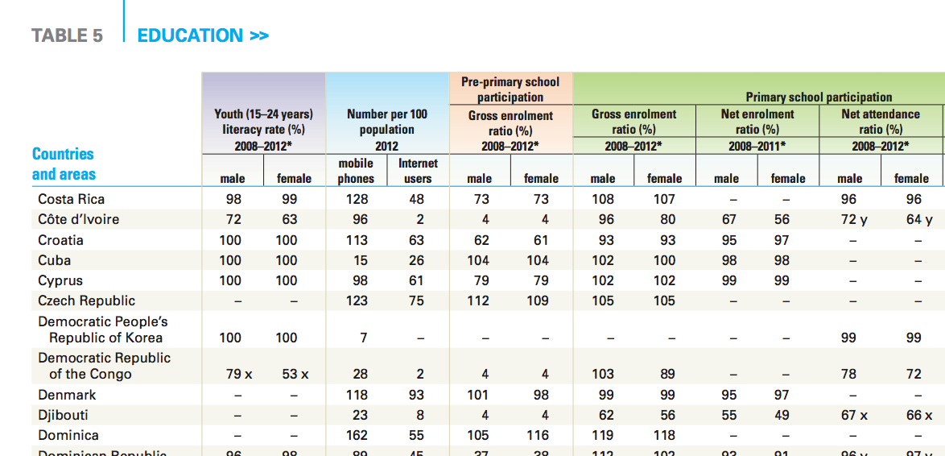
Normalising
Use pd.stack()
Notes:
You can normalise your tables in Pandas by using the stack function - see e.g. http://pandas.pydata.org/pandas-docs/stable/reshaping.html
[Image: UNICEF state of the world’s children report]

Slide 29
The Seaborn Library
Notes:
Seaborn is a powerful python visualisation library designed for data science use.

Slide 30
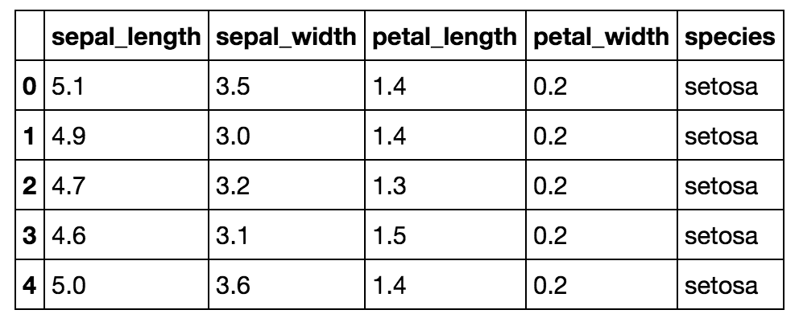
The Iris dataset
import seaborn as sns
iris = sns.load_dataset('iris')
Notes:
Seaborn includes some example datasets, including the iris dataset that we met in the machine learning session.

Slide 31
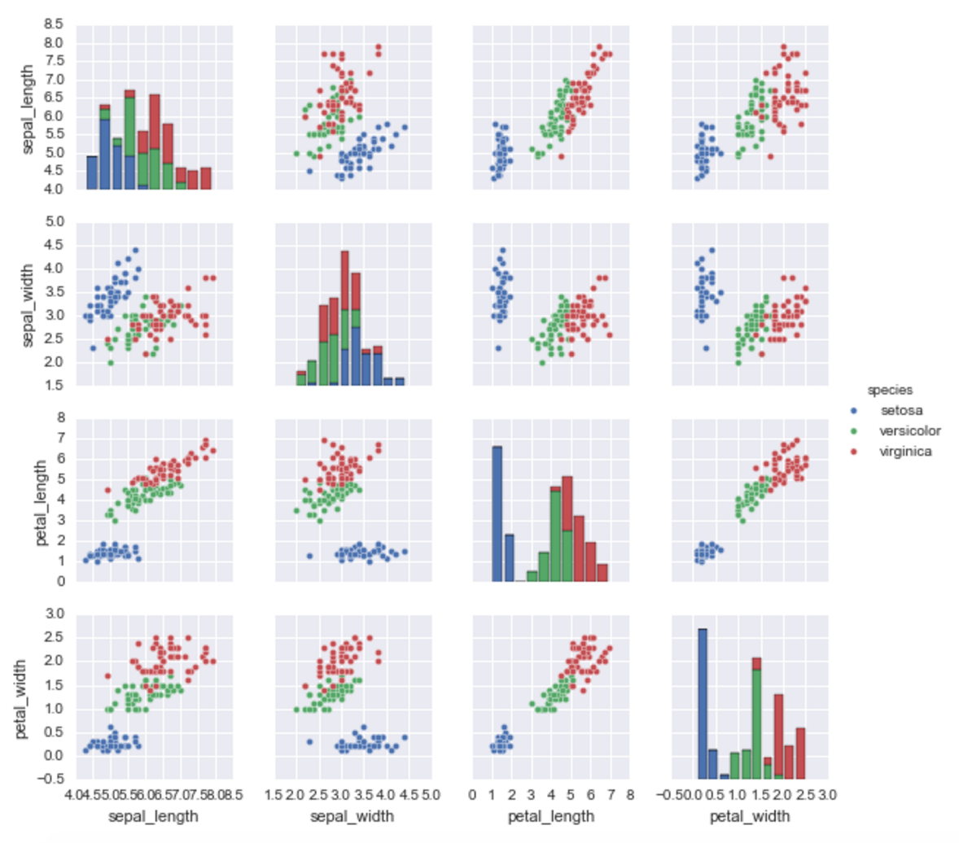
Visualising Iris data with Seaborn
sns.pairplot(iris, hue='species', size=2)
Notes:
NB You might want to do “sns.set()” before plotting, to change to the default Seaborn style.

Slide 32
Exploring with R
Notes:
The most common data science coding languages are Python and R. We’re not going to teach R in these sessions, but you at least need to know how to run and use R files.

Slide 33
R
Matrix analysis (similar to Pandas)
Good at:
  Rapid statistical analysis (4000+ R libraries)
  Rapidly-created static graphics
Not so good at:
  Non-statistical things (e.g. GIS data analysis)

Slide 34
Running R code
Running R files:
  From the terminal window: “R <myscript.r —no-save”
  From inside another R program: source('myscript.r')
Writing your own R code:
  iPython notebooks: create “R” notebook (instead of python3)
  Terminal window: type “r” (and “q()” to quit)
  Rstudio: click on Rstudio tool
Notes:
You can also run R from Python code, using the rpy2 library.

Slide 35
Exercises

Slide 36
Code
Try running the Python and R code in the 5.x set of notebooks

